Slide 1
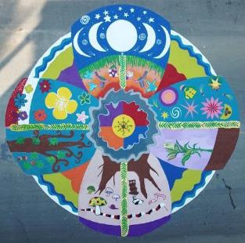
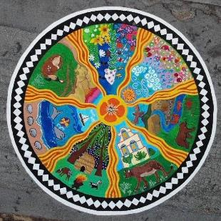
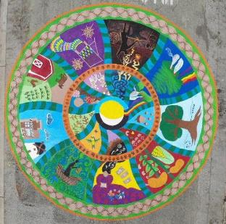
Compassionate San Juan Bautista City of San juan Bautista Mandala Community Arts Project Art SJB 2019

Slide 2
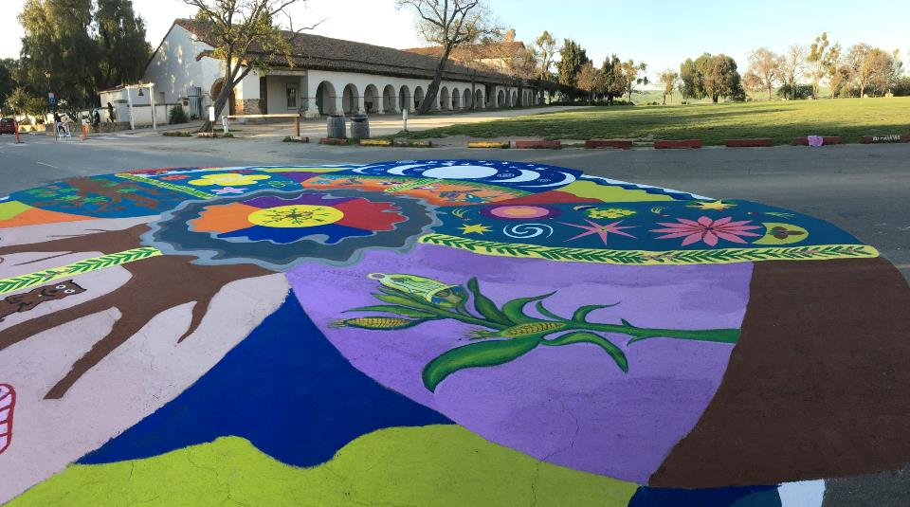

Slide 3
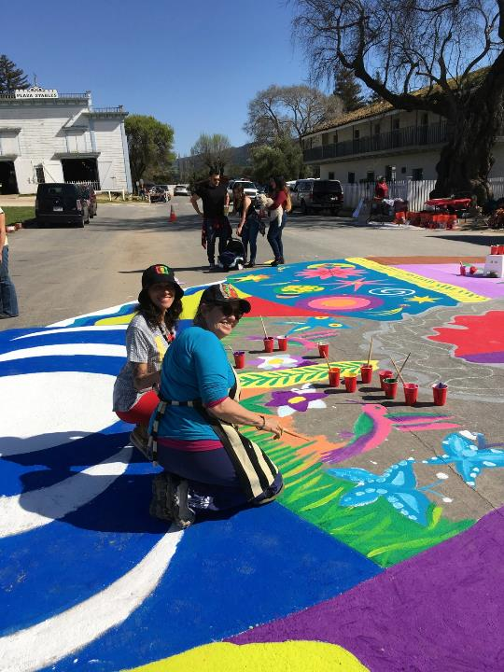
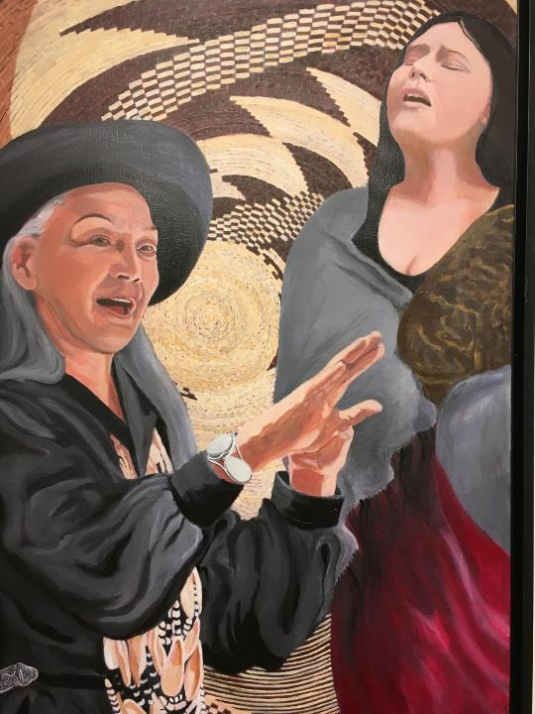
Painting by Darlene
Boyd

Slide 4
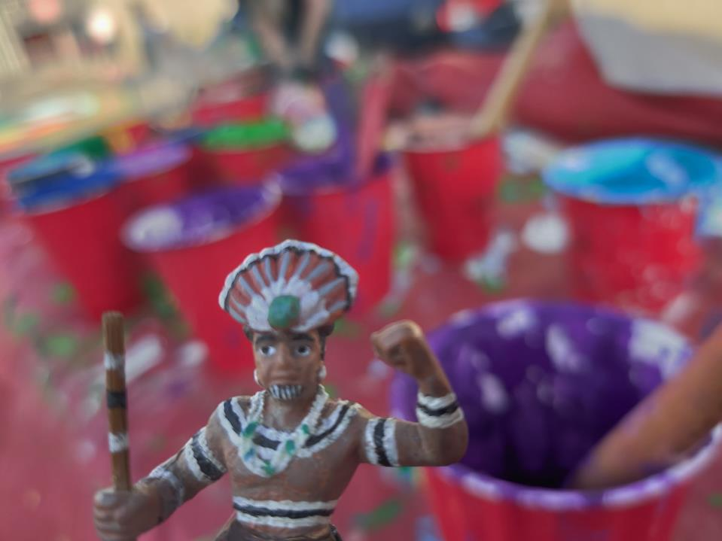
This year long art project brought the community together to reflect on the history and present practice of indigenous people of the central coast of California, by honoring stories, seasons, the earth and plant and animal life in four mandala paintings. Participants of all ages from 2 – 82 joined in painting on the street mentored by River Sauvageau.

Slide 5
This year long art project brought the community together to reflect on the history and present practice of indigenous people of the central coast of California, by honoring stories, seasons, the earth and plant and animal life in four mandala paintings. Participants of all ages from 2 – 82 joined in painting on the street mentored by River Sauvageau.

Slide 6
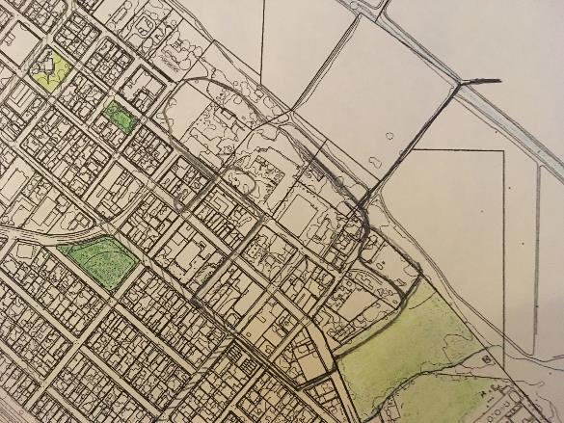
San Juan Bautista Cultural Walking Tour
Our Compassionate goal is a recognition of indigenous histories in a California Mission town.

Slide 7
Honor Ancestors

Slide 8
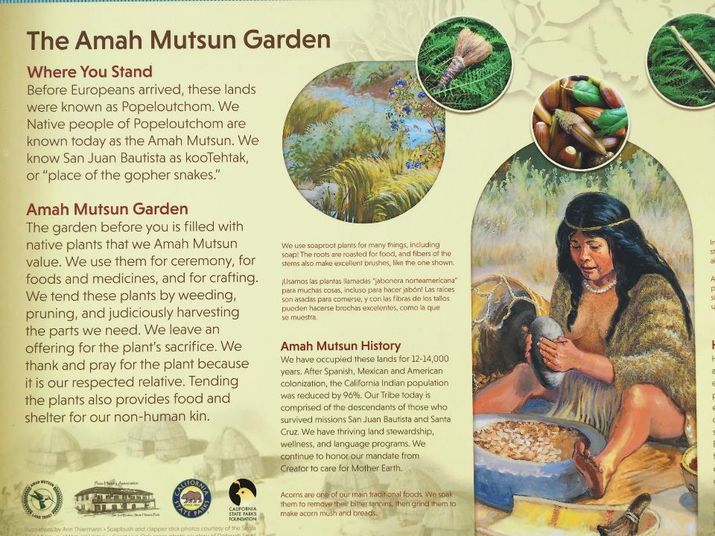

Slide 9
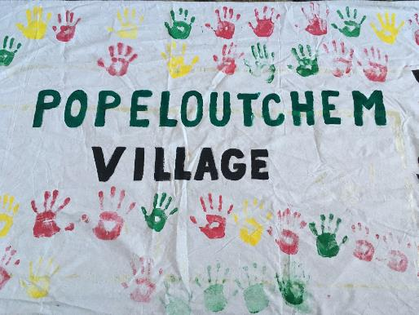
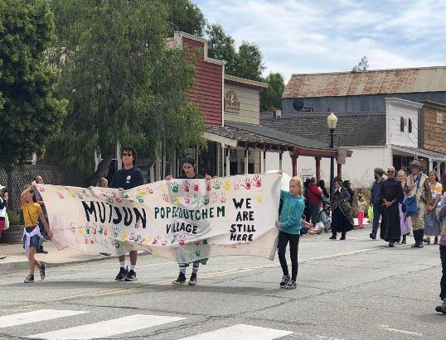
150

Slide 10
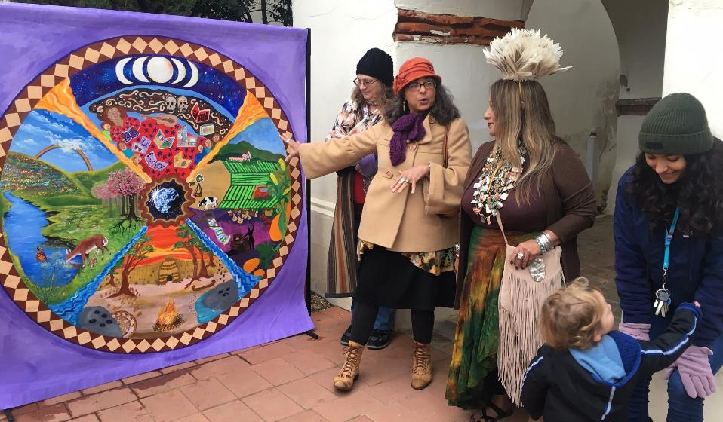
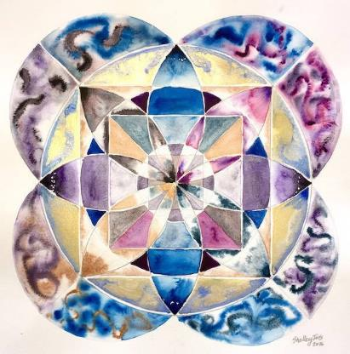
Compassionate California/ Cities Compassionate Arts SJB

Slide 11
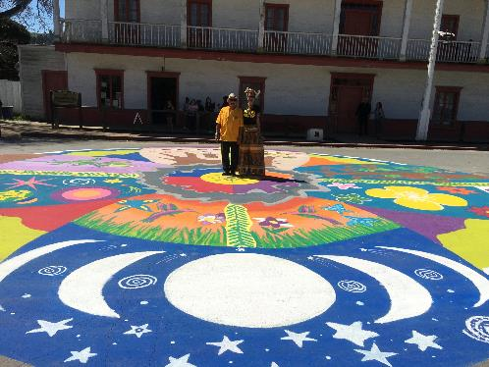
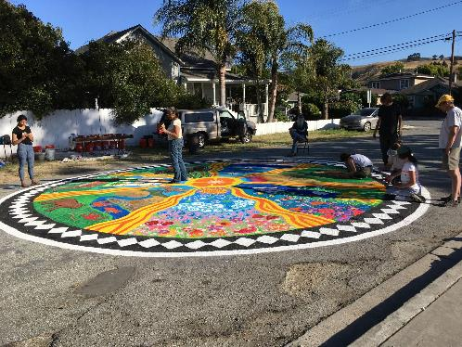
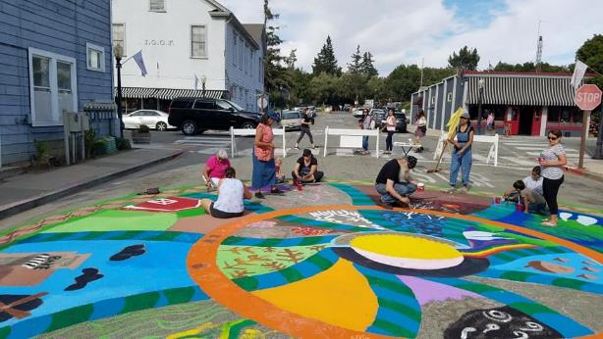

Slide 12
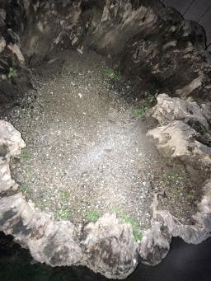
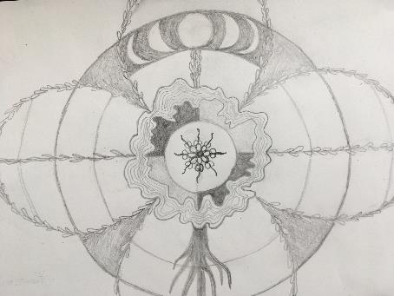
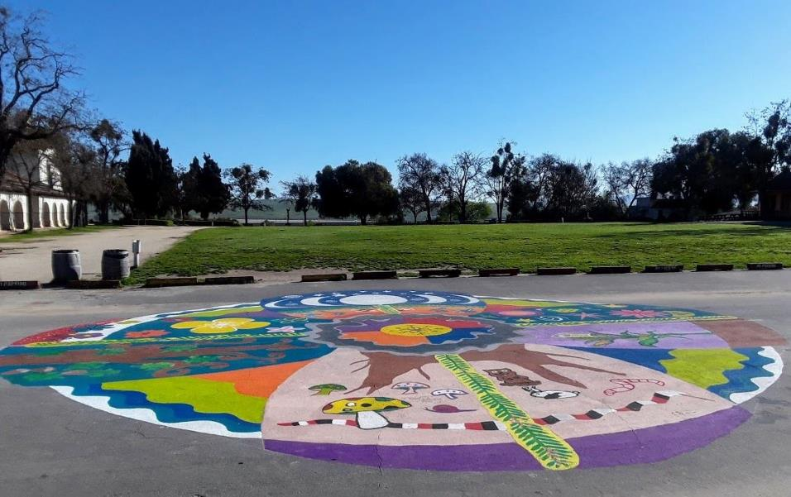
Spring

Slide 13
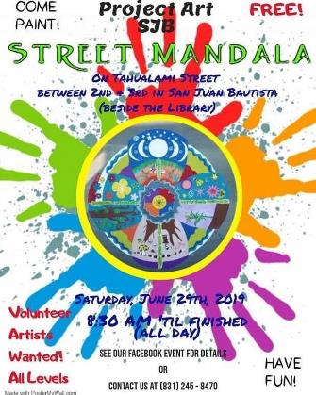
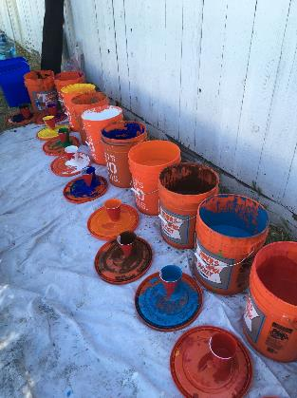
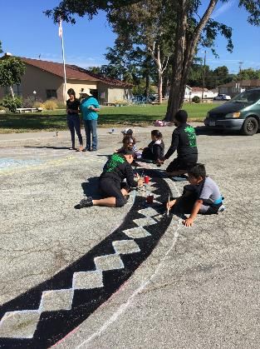
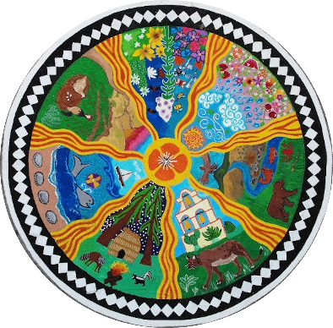
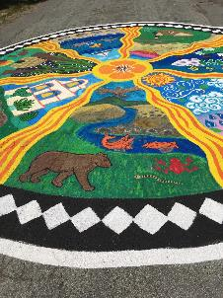
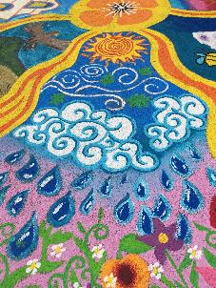
Summer

Slide 14
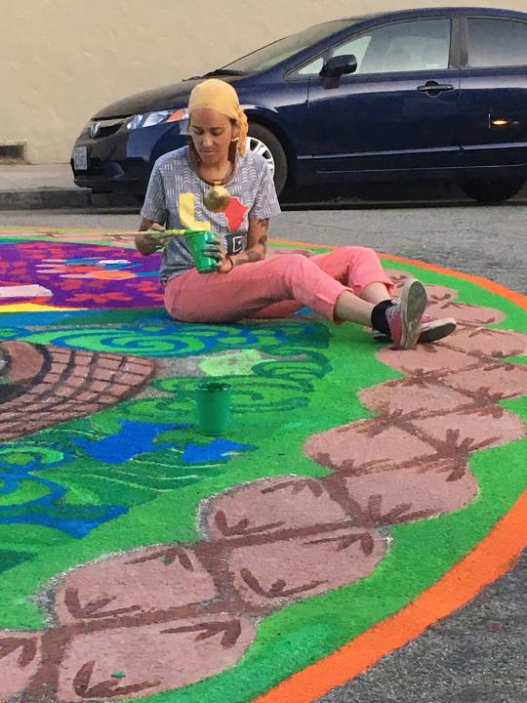
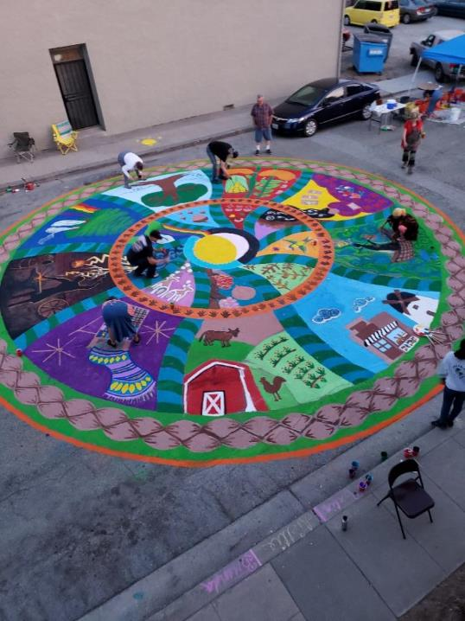
Autumn

Slide 15
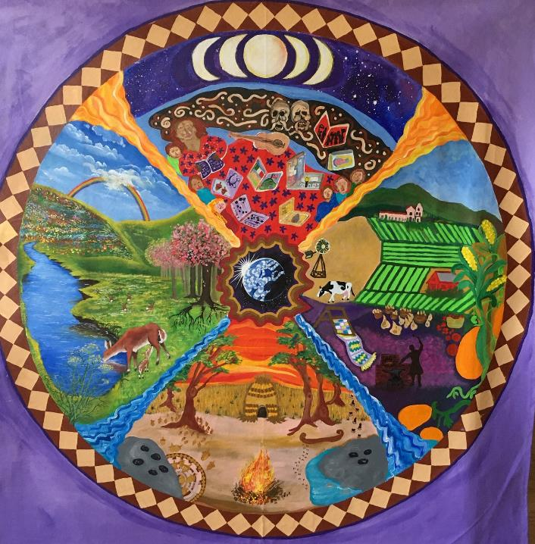
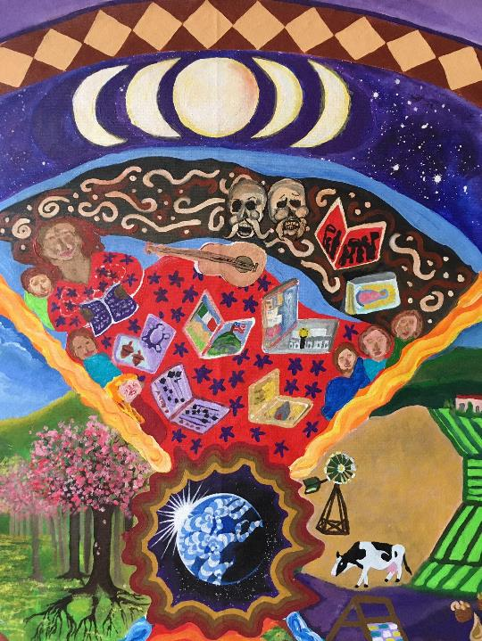
Story
teller
Winter

Slide 16
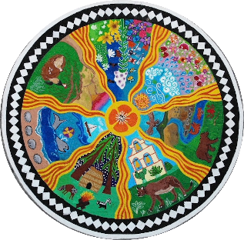
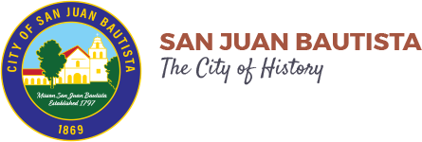
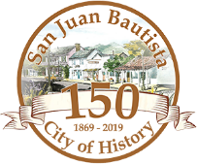
Project Art SJB

Slide 17
Project Art SJB

